Slide 1

Details of the Team and Problem Statement
Ministry/Organization Name/Student Innovation: Ministry of Jal Shakti
PS Code : SIH 1293
Problem Statement Title : Automatic regulation of valves for release of water based upon soil moisture availability in the root zone of the crop, using artificial intelligence, in a piped and micro irrigation network of irrigation system.
Team Name : Blake Association
Team Leader Name: NS Surya
Institute Code (AISHE): U-0436
Institute Name: Amrita Vishwa Vidyapeetham
Theme Name: Agriculture, Food Tech & Rural Development

Slide 2
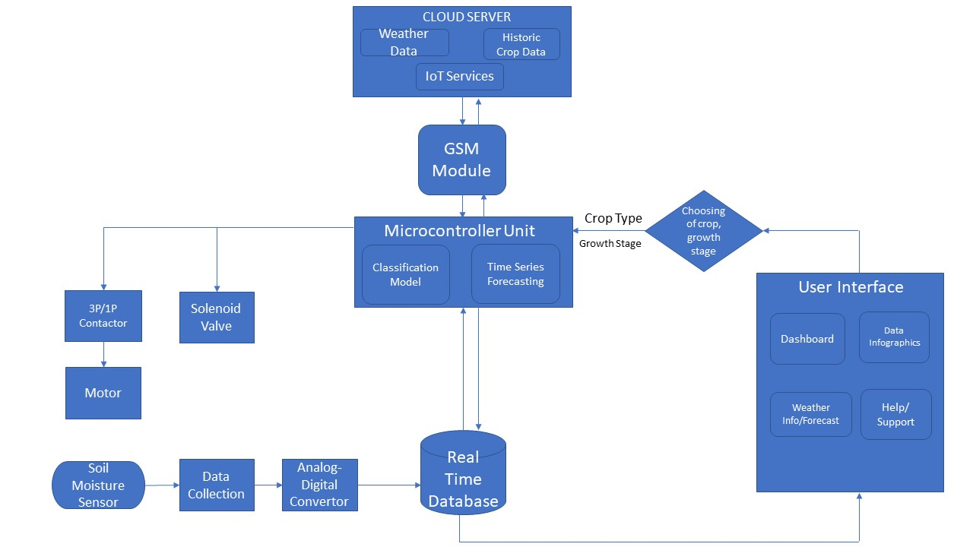
Idea/Approach Details
Precision water irrigation system
1. Water as we know is one of the most imp resources for agriculture .According to ICAR 70% of the irrigation water is wasted due to traditional and outdated agricultural system.
2. For this problem, our solution entails the development of a comprehensive AI driven irrigation system tailored for piped and micro irrigation along with Internet of Things for the inter-connection.
3. The core idea is to enable the automatic regulation of valve based on real time soil moisture data collection from the crop’s root zone.
4. By leveraging AI/ML models it(the microcontroller) will dynamically adjust valve operations to precisely match the crop’s water requirements based on the calculations done using the inputs.
5.Creating a collection of devices to monitor, exchange and convey irrigation information using IoT.
6. All of this will be presented in a user-friendly interface, in a lang of the farmer’s choice.
7. Benefits: The primary benefits of this technique is the optimized water usage, increased crop yields and economic output.
Hardware Stack
1. Microcontroller: Arm® Cortex M Series
2. Soil Moisture Sensor and ADC module
3. Secondary Memory
4. Solenoid Valves
5. Cloud Server
6. Pump and 3 Phase Contactor
Software Stack
Weather Forecast Data from Vendors.
Machine Learning Models: Time Series Forecasting and Classification
Thresholding: finding the optimal range of irrigation
IoT for inter-connection of MCUs, pumps, relays and user app
UI / UX for end user along with accessibility features

Slide 3
Idea/Approach Details
Describe your Use Cases here
Describe your Dependencies / Show-stopper here
Use case 1:
Explaining how our model works for all types of crops
Challenges:
Water scarcity and wastage
Climate dependency
Solution: AI-driven irrigation system with real time weather integration
Benefits:
Optimized water usage
Enhanced crop yields
User friendly interface
Mitigating water stress
Soil Health
Government Revenue
Dependency of labor is reduced
Use case 2:
Scenario: A sugarcane farmer embraces our irrigation system
Crops like sugarcane are extremely essential for ethanol production which helps lower our country’s import bills due to the reduction in fossil fuel consumption.
Sugarcane being a water intensive crop, requires a great amount of water. However when there is scanty rainfall, it impacts the production of the crops.
With Cellular (3G / LTE / 5G)
End user mobile with SIM
Cellular network provider
Server for weather API and IoT platform
Without Cellular
GSM / GPRS Module
Fully wired interconnect with BT service to end user.
Keypad phone with BT is minimum requirement.
Common Dependencies
Microcontroller, ADC and SD card manufacturer
Soil moisture probe and Solenoid valve manufacturer
Pump wattage
Source of electricity
Collection of Datasets for training
Python libraries for model training (pre-hand) (TensorFlow, Scikit-Learn)
Choices in communication interfaces between MCU – Model – UI
Data backup and recovery using DB (IBM DB2)
Making the UI/UX compatible with different version of OS on user’s device.
Software Development for User Application

Slide 4
Team Member Details
Team Leader Name: NS Surya
Branch (BTech/MTech/PhD etc.): B.Tech. Stream : CSE Year (I,II,III,IV) : III
Team Member 1 Name: Ramnaresh Ulaganathan
Branch (BTech/MTech/PhD etc.): B.Tech. Stream : CSE Year (I,II,III,IV) : III
Team Member 2 Name: Sai Mohnish M
Branch (BTech/MTech/PhD etc.): B.Tech. Stream : CSE Year (I,II,III,IV) : III
Team Member 3 Name: Ankita Venu
Branch (BTech/MTech/PhD etc.): B.Tech. Stream : CSE Year (I,II,III,IV) : III
Team Member 4 Name: ARAVINDH
Branch (BTech/MTech/PhD etc.): B.Tech. Stream : CSE Year (I,II,III,IV) : III
Team Member 5 Name: Abhimanyu V
Branch (BTech/MTech/PhD etc.): B.Tech. Stream : CSE Year (I,II,III,IV) : III
Team Mentor 1 Name: Dr Anbazhagan Mahadevan
Category (Academic/Industry): Academic Expertise : ML Domain Experience (in years): 13

